Slide 1
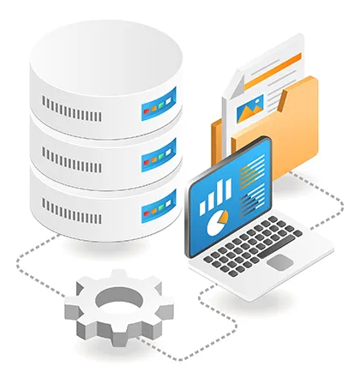
Pharmacy Management System
Presented To:
Dristi Saha
Lecturer
Department Of CSE
Presented By:
Nurjahan Akther Mim 221-15-4782
Abu Zahed 221-15-4716
Md Amir Hamja 221-15-4784
Arnub Datta 221-15-4726

Slide 2

Pharmacy Management System
A Pharmacy Management System (PMS) is a software application designed to streamline and automate the operational aspects of a pharmacy. It integrates various functions to ensure efficient management of inventory, sales, prescriptions, and customer information.

Slide 3


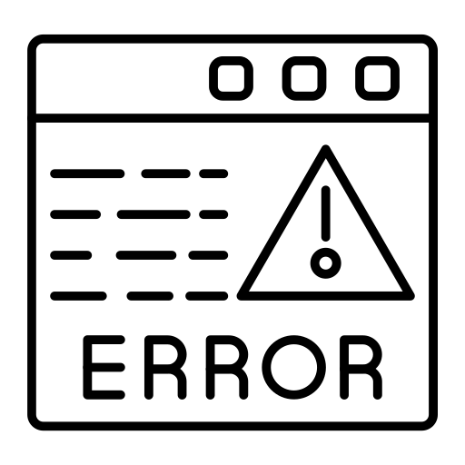

Motivation
Enhanced Customer Service
and Satisfaction
Compliance with Regulations
and Security
Improved Efficiency and
Reduced Errors
Real-Time Inventory
Management
Scalability and Growth

Slide 4





Objective
MEET OUR CO-FOUNDERS
Efficient Management
Error Reduction
Time-Saving
Data Accessibility
Scalability and Security

Slide 5
Computers
Hardware Tools
Barcode Scanners
.
Receipt Printers
Point of Sale (POS) Devices

Slide 6





Tools Used In Project
XAMPP
MYSQL
JAVA
JFRAME
NETBEANS

Slide 7
Worker Management
Sales and Billing System
Key
Features
Medicine Management
Inventory Tracking
Secure Login and Access Control
Company Management

Slide 8
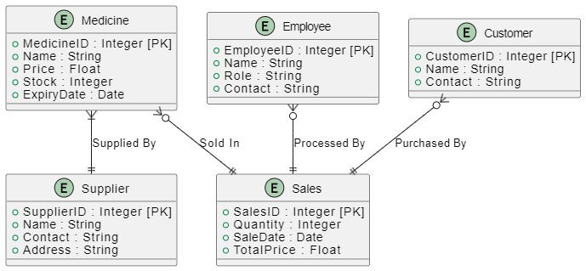
ER Diagram
The ER Diagram for the Pharmacy Management System includes five key entities: Medicine, Supplier, Employee, Sales, and Customer. The Medicine entity tracks product details, linked to the Supplier who provides the medicines. Sales logs transactions, connected to Medicine, Employee, and Customer entities. Each sale involves an employee and a customer, while multiple medicines can be part of a sale. This diagram establishes clear relationships, enabling efficient management of inventory, staff, transactions, and customer information in the system.

Slide 9
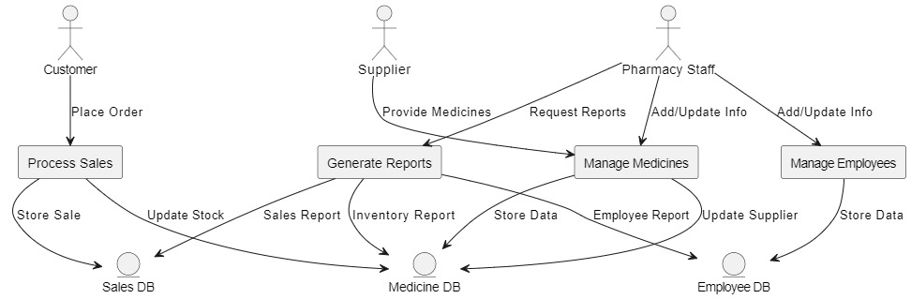
Use Case
.
The Pharmacy Management System works by handling customer orders through the Process Sales function, which updates the sales records and adjusts medicine stock levels. Pharmacy Staff manage medicines and employee data using the Manage Medicines and Manage Employees processes, storing all information in the respective databases. Staff can also generate reports on sales, inventory, and employees using the Generate Reports process. Suppliers provide medicines, with updates stored in the Medicine Database. This system streamlines order management, inventory control, employee data handling, and report generation.

Slide 10
Conclusion
The Pharmacy Management System (PMS) provides a comprehensive solution for streamlining pharmacy operations, enhancing efficiency, and reducing errors. By integrating key functionalities such as inventory tracking, sales and billing, secure login, and worker management, the system ensures effective management of pharmacy resources. Additionally, compliance with regulations, scalability, and enhanced customer service contribute to its value proposition. This project demonstrates how technology can transform and optimize the pharmacy sector, paving the way for improved healthcare service delivery
.

Slide 11
THANK YOU!

